Slide 1


Employee Data Management System
Prepared By :
Name: Fichadiya Aryan
Roll No: 67
Batch: C3
Enrollment: 24002171810008
Branch: CSE_DS

Slide 2
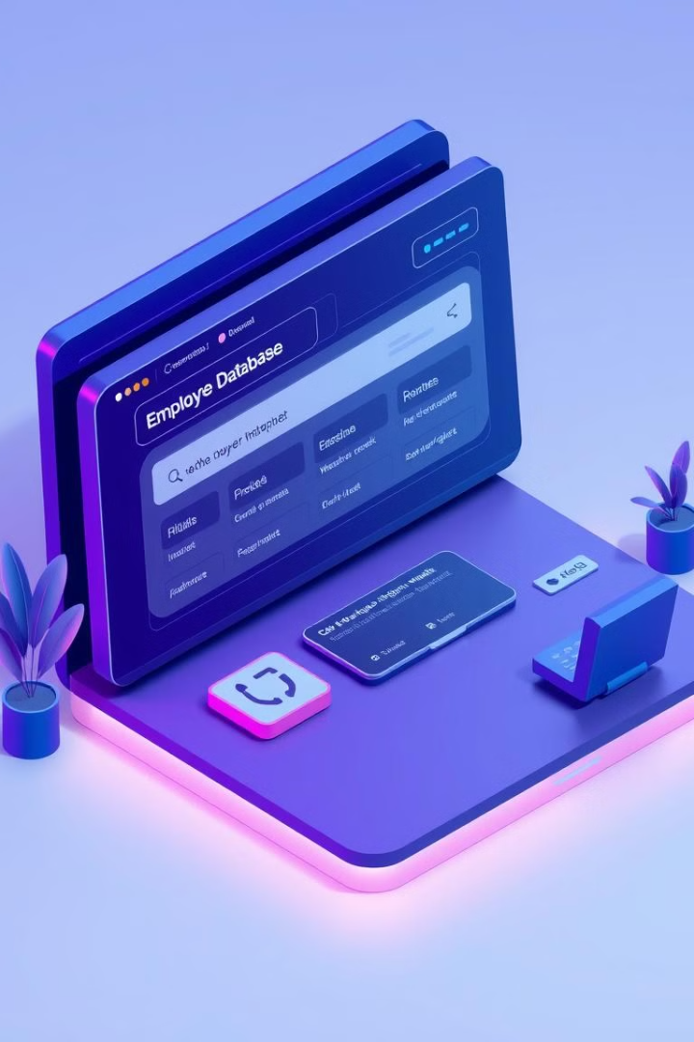
Employee Data Management System
A Java-based application for efficiently managing employee records. This system is designed to store, update, and retrieve employee information. It uses Java to manage employee details, ensuring data integrity.

Slide 3
Introduction
What is this project?
Purpose
Key Functionality
This is a Java-based console application to manage employee details.
It stores, updates, and retrieves employee information efficiently.
Designed to streamline typical HR tasks.

Slide 4
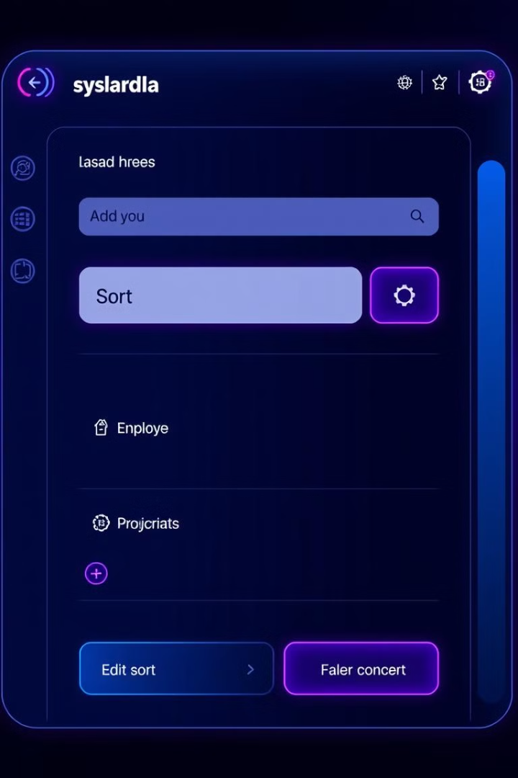
Features
1
Adding New Employees
Allows adding new employee records.
2
Generating Unique IDs
Generates unique IDs for each employee.
3
Sorting Employees
Sorts employees by salary & experience.
4
Searching Employees
Searches by name or ID.

Slide 5




Technologies Used
Programming Language: Java
Development Environment
Concepts Used
OOP, data structures, user input.
Core language for the system.
Notepad++ is used.

Slide 6
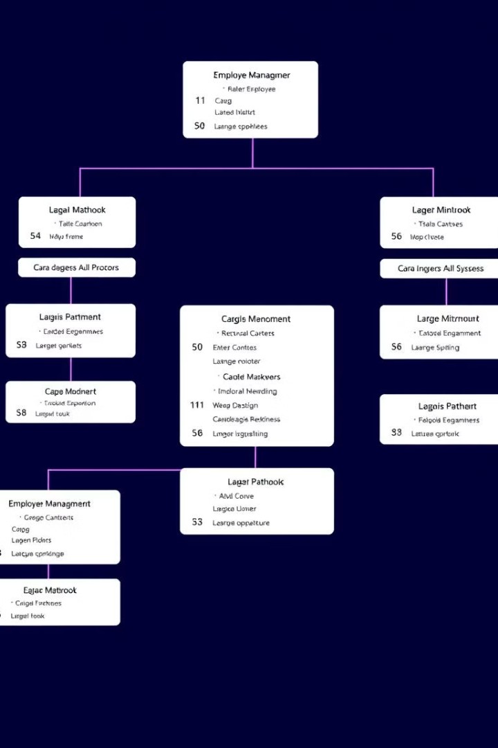



Code Structure
Employee Class
Stores attributes and implements sorting.
Employee Data Class
Main method interacts with users.
Methods
Menu-driven operations.

Slide 7
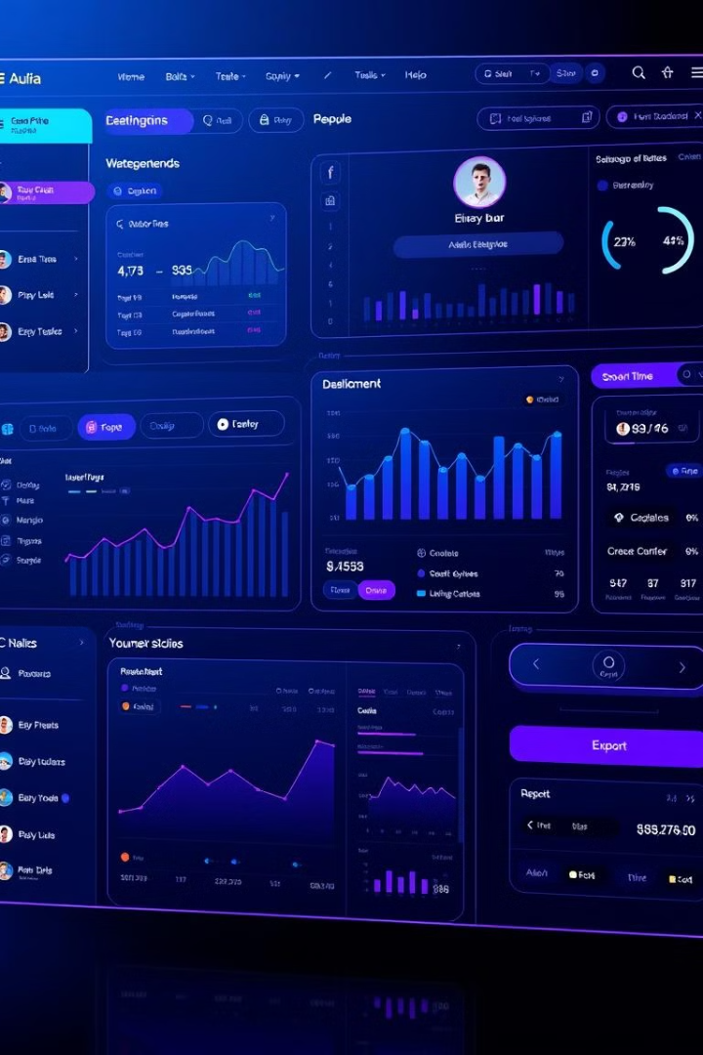
Future Improvements
1
Graphical Interface
GUI for user interaction.
2
Database Integration
MySQL database implementation.
3
Data Export
Export to CSV or Excel.
4
Multi-User Access
Login system.

Slide 8
Merits | DeMerits
Structured Data Handling | Inefficient Data Storage
Encapsulation & Data Security | No Exception Handling
Error Handling for Invalid Choices | Limited Input Validation for Designation
Multiple Functionalities
Validation for User Input

Slide 9

Conclusion
A simple, effective system demonstrating Java OOP and data handling. Real-world potential for enterprise applications. This project demonstrates effective data management.

Slide 10
Thank You

